Slide 1

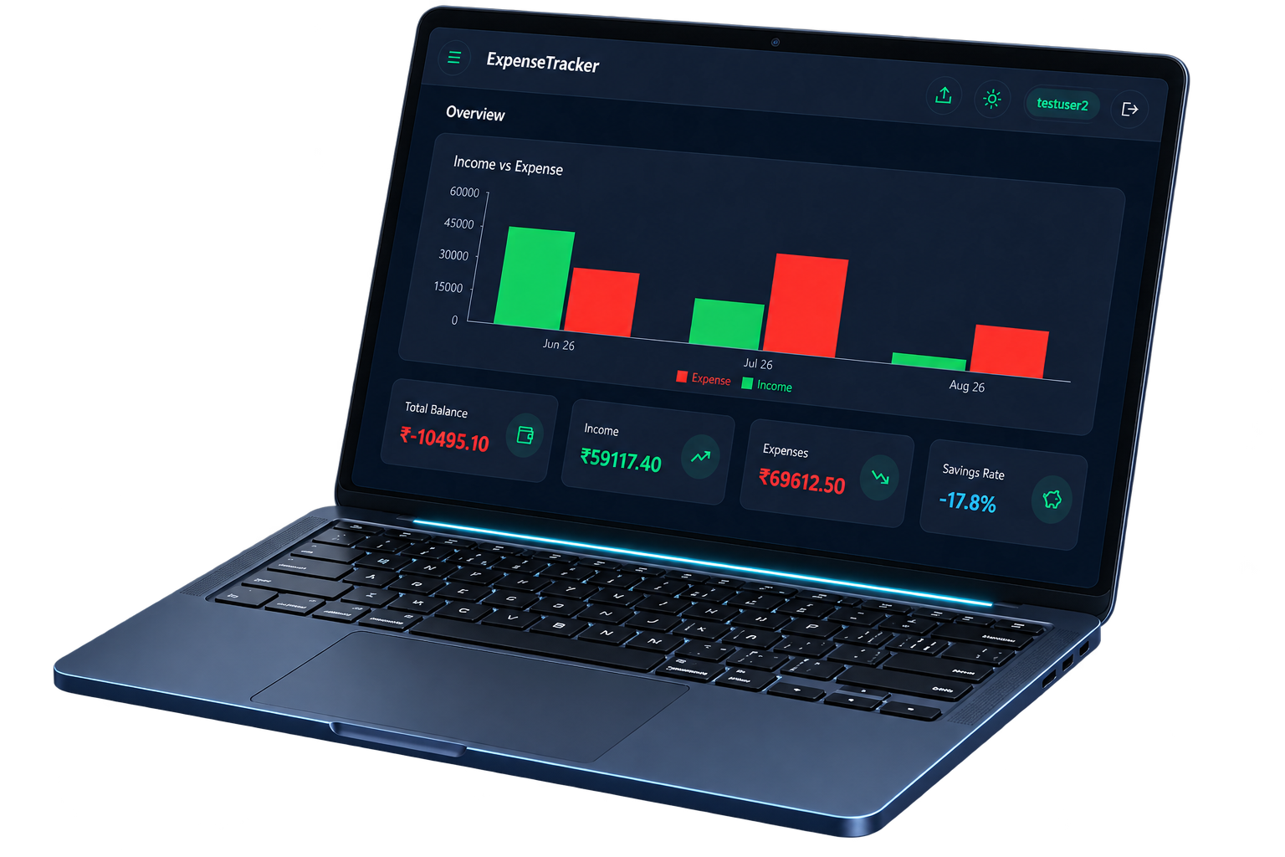
CVV LOGO
CSE 2 • S5 MINOR PROJECT • 0TH REVIEW
AI-Powered Smart
Expense Tracker
Automated parsing, AI categorization, and intelligent budgeting for personal finance.
TEAM
GUIDE
Ms. Kripa Radhakrishnan
Akhilesh A (241140110)
Gokul Sajith (241140129)
Assistant Professor – Department of CSE
Vishnu Vijay (241140120)
01

Slide 2




PROJECT SUMMARY
Abstract
A web app where a user uploads their bank statement, and the app automatically reads every transaction, uses AI to figure out what category each one belongs to (Food, Bills, Shopping, etc.), and shows it all on a dashboard with charts and insights. Unlike existing trackers that require manual entry or only report raw data, our system automates the entire process and adds proactive guidance, such as, budget alerts, AI savings suggestions and user-correctable categorization, while remaining completely free and open.
In Short:
02

Slide 3




AUTOMATE → SECURE → MONITOR → OPTIMIZE
Objectives
CVV LOGO
01
02
Automate
Secure
Automate extraction and categorization of transactions from bank statements (PDF/CSV) using AI
Provide a secure, user-specific dashboard for tracking income, expenses and spending trends
03
04
Monitor
Optimize
Enable budget limit setting with real-time alerts across overall and per-category spending
Generate AI-driven spending insights and personalized savings suggestions
03

Slide 4




FRAGMENTED • MANUAL • LIMITED INTELLIGENCE
Existing System
CVV LOGO
Manual Tracking Apps
Bank Apps
Spreadsheet Tracking
Existing Tools
Manual expense tracking apps require users to enter every transaction by hand
Bank apps show raw transaction lists without meaningful categorization or insights
Spreadsheet-based tracking is time-consuming and prone to errors
Most existing tools lack automated statement parsing or AI-based categorization
04

Slide 5

LIMITATIONS OF THE CURRENT APPROACH
Disadvantages
CVV LOGO
01
High Manual Effort
02
No Automatic Categorization
High manual effort discourages consistent tracking, leading to inaccurate records
No automatic categorization means users must label every transaction themselves
03
Limited Personalization
04
No Proactive Alerts
Little to no personalized insight into spending behavior or savings opportunities
Absence of proactive budget alerts allows overspending to go unnoticed
05

Slide 6





END-TO-END DATA FLOW
Proposed System
CVV LOGO
PDF / CSV
Statement
Parsing
AI
Categorization
Secure User
Data
Interactive
Dashboard
PDFBox · Apache Commons CSV · Google Gemini API · JWT · Dashboard
Upload bank statements (PDF/CSV) and auto-parse transactions using PDFBox and Apache Commons CSV
Use the Google Gemini API to automatically categorize transactions and identify merchants
01
02
Secure JWT-based authentication with per-user data isolation
Interactive dashboard with charts, budget alerts, and AI-generated savings tips
03
04
06

Slide 7


WHY THIS APPROACH WINS
Advantages
CVV LOGO
Automation
Accuracy
Eliminates manual data entry through automated statement parsing
AI categorization saves time and improves accuracy over manual tagging
Proactive Budgeting
Visual Analytics
Real-time budget alerts help users control overspending proactively
Visual analytics (pie charts, trend charts) make spending patterns easy to understand
07

Slide 8





TECHNICAL REQUIREMENTS
Hardware and Software
Specifications
CVV LOGO
Hardware
Backend
Frontend
APIs and Libraries
Development Tools
Standard PC / laptop
Minimum 4GB RAM
Stable internet connection
Java 21
Spring Boot 3.5
MySQL
React
Tailwind CSS
Recharts
Google Gemini API
Apache PDFBox
Apache Commons CSV
IntelliJ IDEA
VS Code
Postman, Git
08

Slide 9
SIX-STAGE DEVELOPMENT PIPELINE
Methodology
CVV LOGO
01
Requirement Analysis
04
AI Integration
Requirement analysis and technology stack finalization
AI integration: Gemini API for categorization, merchant extraction, and savings suggestions
02
Backend Development
05
Frontend Development
Backend development: entity design, JWT authentication, transaction CRUD APIs
Frontend development: dashboard, analytics, budget alerts and insights UI
03
Statement Parsing
06
Testing & Refinement
Statement parsing module: PDF and CSV parsers converging into a unified transaction format
End-to-end testing and iterative refinement of each module
09

Slide 10













TECHNOLOGY ECOSYSTEM
Tools Used
CVV LOGO
Backend
Frontend
Java
Spring Boot
MySQL
m Maven
React
Tailwind CSS
Recharts
Axios
AI & Parsing
Development
Google Gemini API
Apache PDFBox
IntelliJ IDEA
VS Code
Postman
Git / GitHub
Apache Commons CSV
10

Slide 11


WHAT THE PROJECT DELIVERS
Expected Outcomes
CVV LOGO
Functional Application
Real-Time Dashboard
A fully functional web application that parses bank statements and auto-categorizes transactions
A real-time dashboard showing income, expenses, savings and category-wise spending
Alerts & AI Suggestions
Portfolio-Ready System
Automated budget alerts and AI-generated personalized savings suggestions
A deployable, portfolio-ready full-stack application demonstrating practical AI integration
11

Slide 12



LOOKING FORWARD
Future Enhancements
CVV LOGO
More Formats & Currencies
Mobile Application
Predictive Analytics
Bank API Integration
Support for more bank statement formats and multiple currencies
A mobile application version for on-the-go expense tracking
Predictive analytics to forecast future spending and savings goals
Direct integration with bank APIs for real-time transaction syncing
12

Slide 13

BIBLIOGRAPHY
References
CVV LOGO
IJRASET, “AI Expense Tracker”
Journal Publication
[1]
P. Sahu, A. Pradhan, A. P. Nathan, D. Dewangan, P. Bhagat, and V. Thakur, “AI Expense Tracker,” International Journal for Research in Applied Science & Engineering Technology, vol. 13, no. V, May 2025, doi: https://www.ijraset.com/best-journal/ai-expense-tracker
IJSRED, “Expense Tracker with In-built AI”
Journal Publication
[2]
P. Animuthu Abishek, A. Habeeb, N. M. Balasubramaninan, and K. Sivakumar, “Expense Tracker with In-Built AI,” International Journal of Scientific Research and Engineering Development, vol. 8, no. 2, pp. 2759–2765, Mar.–Apr. 2025, doi: https://ijsred.com/volume8/issue2/IJSRED-V8I2P397.pdf
Spring Boot Documentation
docs.spring.io
[3]
Spring, “Spring Boot Documentation,” Spring. [Online]. Available: https://docs.spring.io/spring-boot/
React Documentation
react.dev
[4]
Meta, “React Documentation,” React. [Online]. Available: https://react.dev/reference/react
[5]
Google Gemini API Documentation
ai.google.dev
Google, “Gemini API Documentation,” Google AI for Developers. [Online]. Available: https://ai.google.dev/gemini-api/docs
13

Slide 14
CVV LOGO
CSE 2 • EXPENSE TRACKER • 0TH REVIEW
Thank You.
Questions and feedback are welcome.
TEAM
GUIDE
Ms. Kripa Radhakrishnan
Akhilesh A (241140110)
Gokul Sajith (241140129)
Assistant Professor – Department of CSE
Vishnu Vijay (241140120)
14

Slide 15
MARKET COMPARISON
Difference
CVV LOGO
 | Expense AI | FinArt | Other AI Trackers | Ours
Cost | Paid (₹260 / week) | Free | Free (mostly) | Free
Input Method | Manual entry, receipts, chat | SMS-based (automatic) | Manual entry, voice, or chat | Upload full bank statement (CSV/PDF)
Historical Data | Limited to logged entries | Only from install date onward | None — starts from first log | Entire past history in one upload
Categorization | AI-based | Rule-based (SMS parsing) | AI, on user-typed text | AI (Gemini), on real transaction data
15

